Slide 1
Installation of Visual Studio 2010 Ultimate

Slide 2
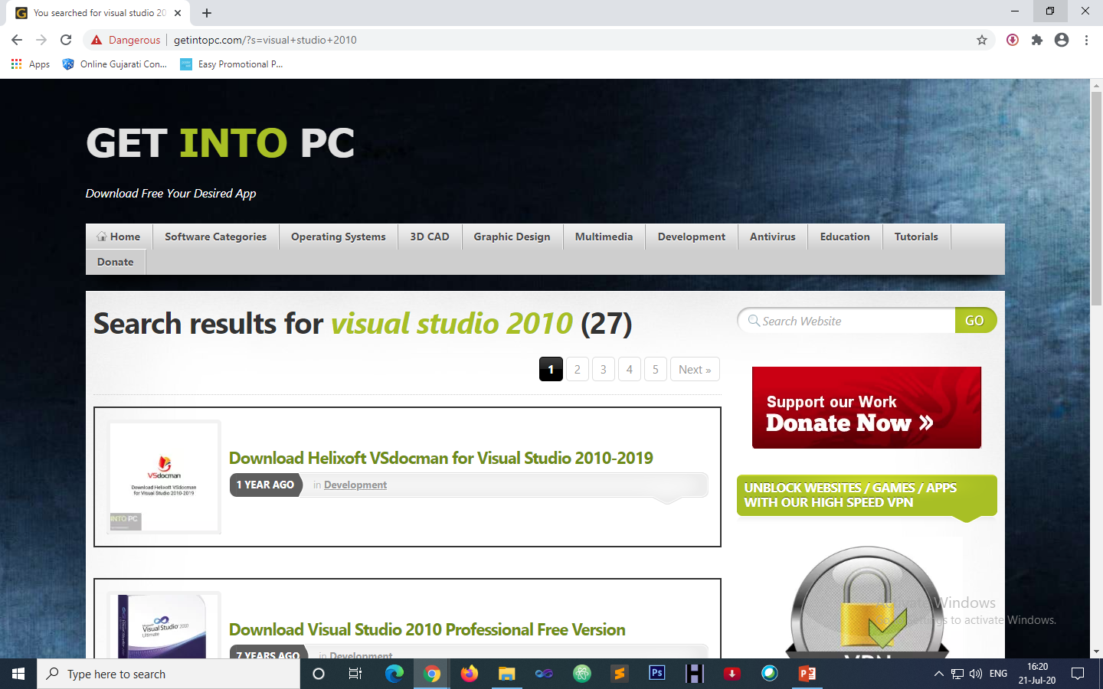
Download Visual Studio 2010 Ultimate
Open link : https://getintopc.com/

Slide 3
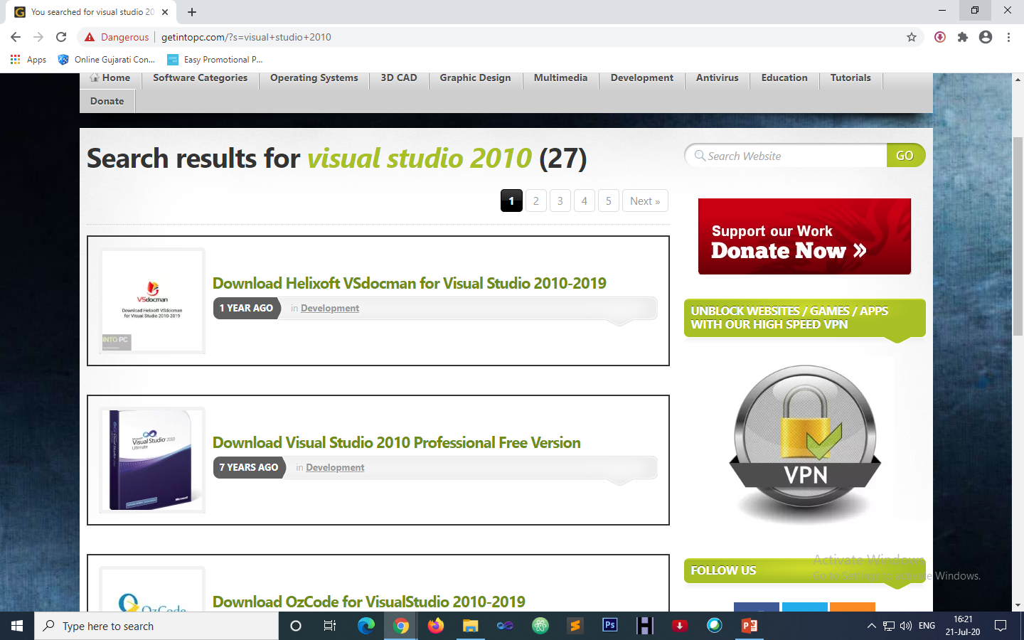
Download Visual Studio 2010 Ultimate
Search Visual Studio 2010 and click on it.

Slide 4
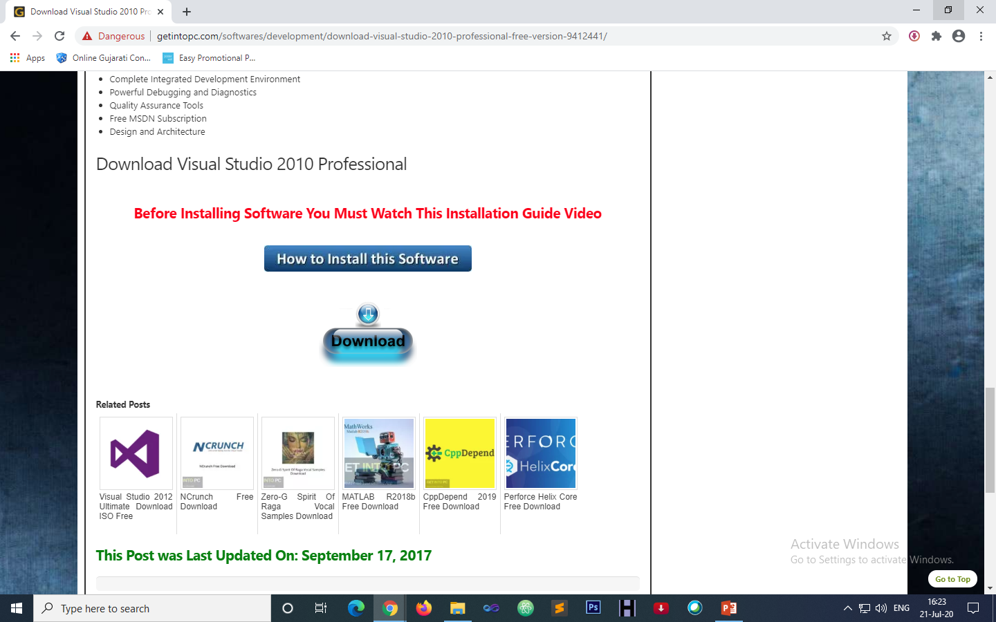
Download Visual Studio 2010 Ultimate
Click on download button

Slide 5
Installation Step-1
Extract downloaded file

Slide 6
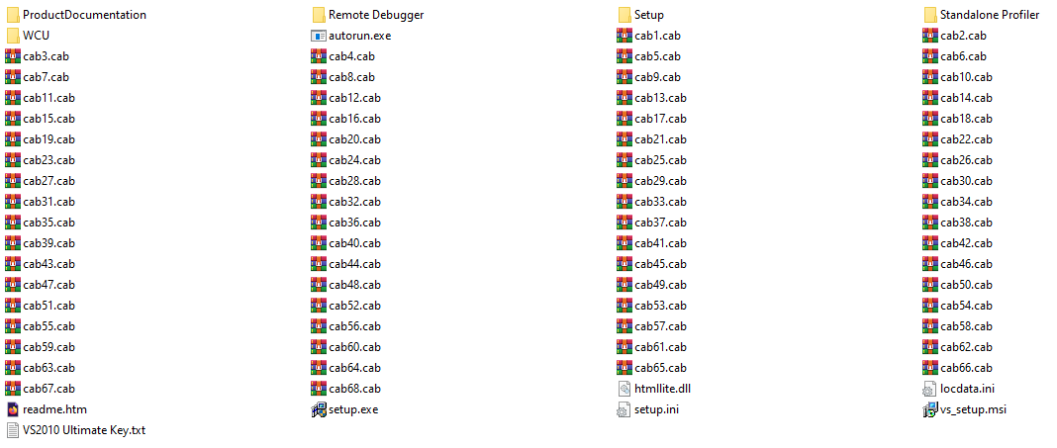
Step-2

Slide 7
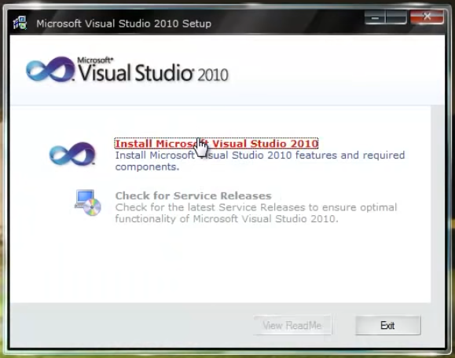
Step-3

Slide 8
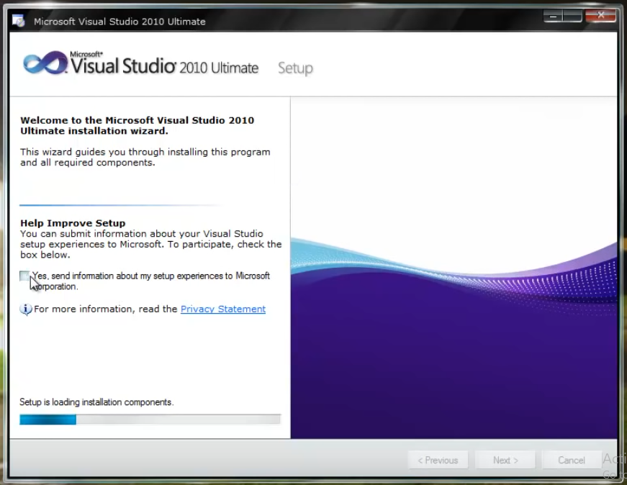
Step-4

Slide 9
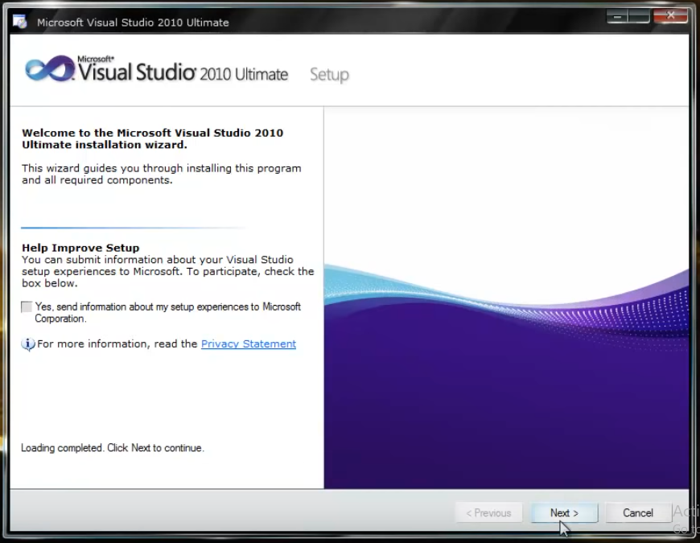
Step-5

Slide 10
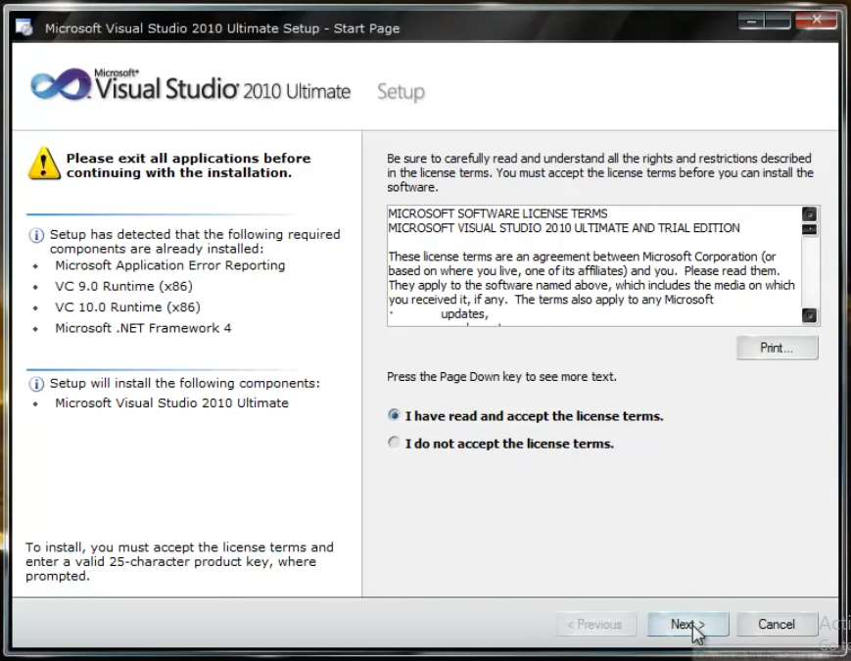
Step-6

Slide 11
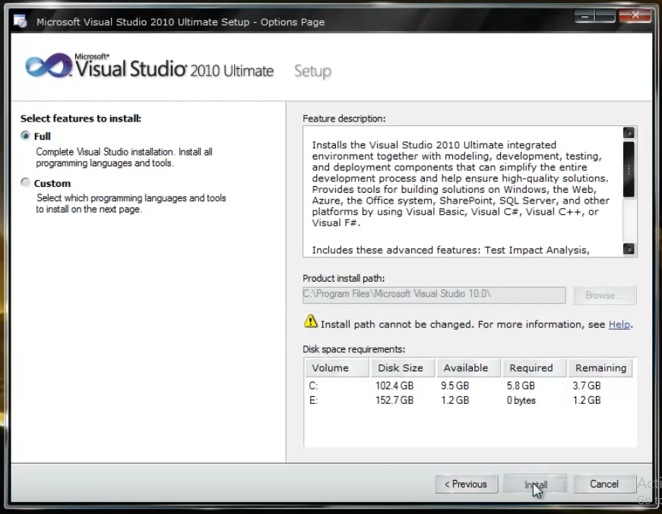
Step-7

Slide 12
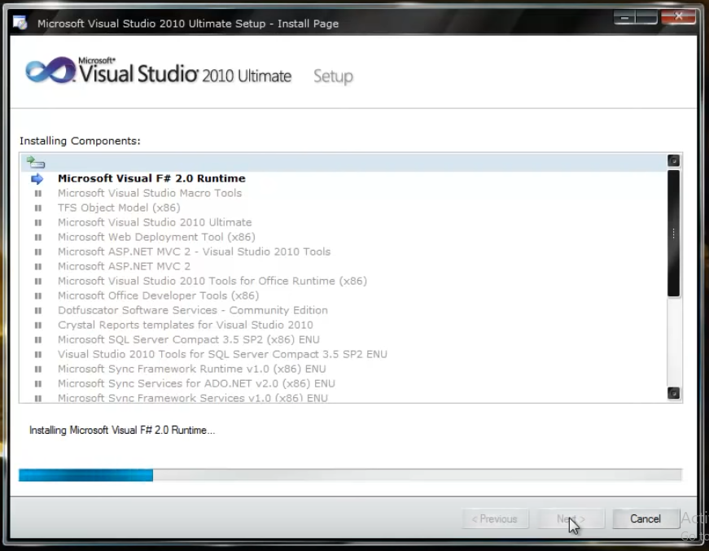
Step-8

Slide 13
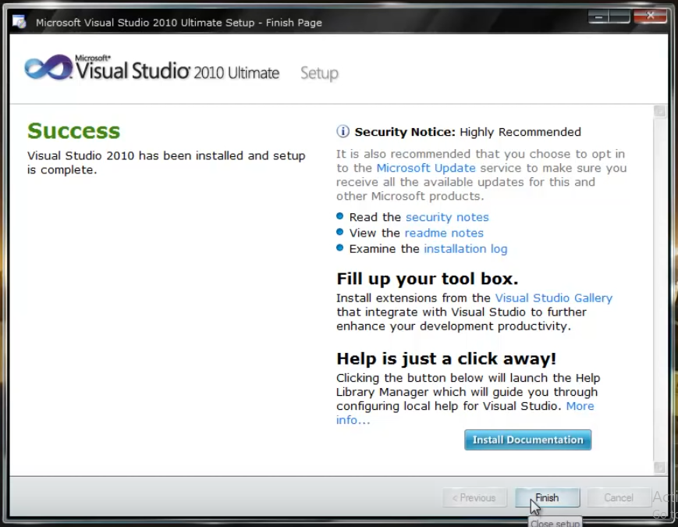
Step-9

Slide 14
Thank You

